Slide 1
Welcome!
September 18, 2014

Slide 2
Pledge
“I pledge on my honor,
to uphold the objects of Key Club International
To build my home, school and community, to serve my nation and god,
And to combat all forces which tend to undermine these institutions.”

Slide 3
Relay For Life
Date October 4th
Location: Yolo County Fairgrounds
Time: 9AM - 9AM (Next morning)
24 hour event
Raise money for those who fight cancer
If interested, talk to Mrs. Suesens as soon as possible

Slide 4
Recycling with Watts
Date: Wednesdays
Time: After School
Location: S109

Slide 5
VOTE: Fourth and Hope Foundation Orientation (Wayfarer Center)
October 7
Date: Tuesday, after school
Location: D101
October 9
Date: Thursday, after school
Location: D101
Notes:
Antonio

Slide 6
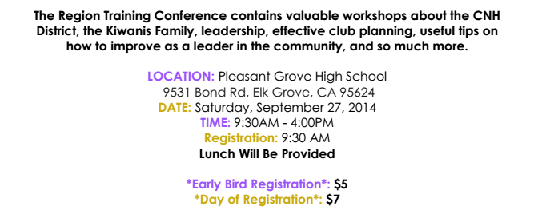
RTC (Get to meet people in our entire Region...)

Slide 7
Future Events
STC
First STC Date: Sept. 20 (Saturday)
Location: William Land Park by Fairytale Town
Time: 12:30-3:45 pm
Fall Rally
Date: Oct. 18 (Saturday)
Location: Six Flags
Early Bird Registration
Due Sept. 26
Pay $32
Day of Registration: $36
Season Pass: $5
MUST PAY DUES TO ATTEND FALL RALLY!!!
Spirit Training Conference (STC)
Fall Rally North
Notes:
Benjamin

Slide 8
Board of Trustees
Details
Involvement in committees
Mandatory board meetings (Tuesdays during lunch) to discuss and plan key club events
Annual term
Details
Involvement in committees
Mandatory board meetings (Tuesdays during lunch) to discuss and plan key club events
Annual term
Freshman Class
Two representatives
Sophomore Class
Two representatives
Junior Class
Two representatives
Senior Class
Two representatives

Slide 9
Reminders
Pay dues: $13.50
Allows you to attend Key Club functions
Will receive credit for hours of community service

Slide 10
Questions?
Comments?
Remember to text @phskey to (424) 835-7340 for reminders about upcoming meetings & events!
Concerns?

